Slide 1

Business Store Analysis
The aim of this project is to derive meaningful business insights from the Superstore US retail dataset and leverage predictive analytics for strategic decision making.

Slide 2
Meat the Team
1- Mai Mamdooh
2- Bassant Maged
3- Khaled Habib
4- Mohamed Adel
5- Asmaa Mahmoud

Slide 3
Main Goals:
Identify the top performing product categories and subcategories
Analyze regional and customer based profitability
Forecast future sales using time series and regression models
Visualize insights through a dynamic, interactive dashboard

Slide 4
About the Data Set:
• Our dataset consisted of 3 main tables:
1- Orders (Fact Table) a total of 9800 rows and 17 columns contains:
product main information from its category and sub-category and whole sales information like product price , discount value and profit
customer information from name and city
order date , ship date and ship mode
2- Returns (Dim Table) a total of 296 rows and 2 columns contain the id of the returned orders.
3- people (Dim Table) a total of 4 rows and 2 columns contain the name of sales-man and it's region.

Slide 5
Data Cleaning & Preprocessing
Tools Used: Python – Pandas

Slide 6
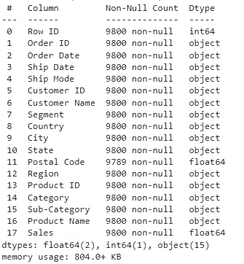
Expolring phase
By exploring data using python we found that the data almost in a clean form except:
1- Postal code column has 11 null values.
All postal code null values found to be to the same state which is “Vermont” by a quick google search found it “05401” and we can fill it manually.
data['Postal Code'] = data['Postal Code'].fillna('05401')
Dates columns (order and ship) were in wrong data format .
There were only 1 dublicated row and dropped it.
Notes:
The data we explored using Python was mostly clean, with a few minor issues that we were able to address. The postal code column had 11 null values, which we were able to fill in manually after determining the missing codes were all for the same state. The date columns for order and ship dates were in the wrong format, so we converted them to the proper date format. There was only 1 duplicated row, which we dropped. Overall, the data is now in a clean, usable state for our analysis.

Slide 7
Transformation
add custom columns useful for the analysis using power query
1- Delivery Duration = Ship Date - Order Date
2- Discount Value = Sales * Discount
Now data ready to be analysed

Slide 8
EDA question
We begin by identifying key questions that help uncover insights:
KPIs:
Total Customers
Financial Performance Analysis
Total Orders
What are the total sales for the store over a specific period?
Total Sales
Total Profit
How do sales compare year-over-year or month-over-month?
Discount Value
Returns Orders
What are the best-selling products/categories?
Returned Orders Cost
What are the peak sales hours/days/weeks?
Average Delivery Duration
How do discounts impact sales?
Regional/Geographical Insights
What are our top sales Cities?

Slide 9
Visualization
Tools Used: Tableau

Slide 10







KPIs
Total Customers
Total Orders
Total Sales
793
5009
2.3M
Total Profit
Discount Value
Returned Orders
0.29M
0.32M
296
Avg delivery duration
4 days

Slide 11
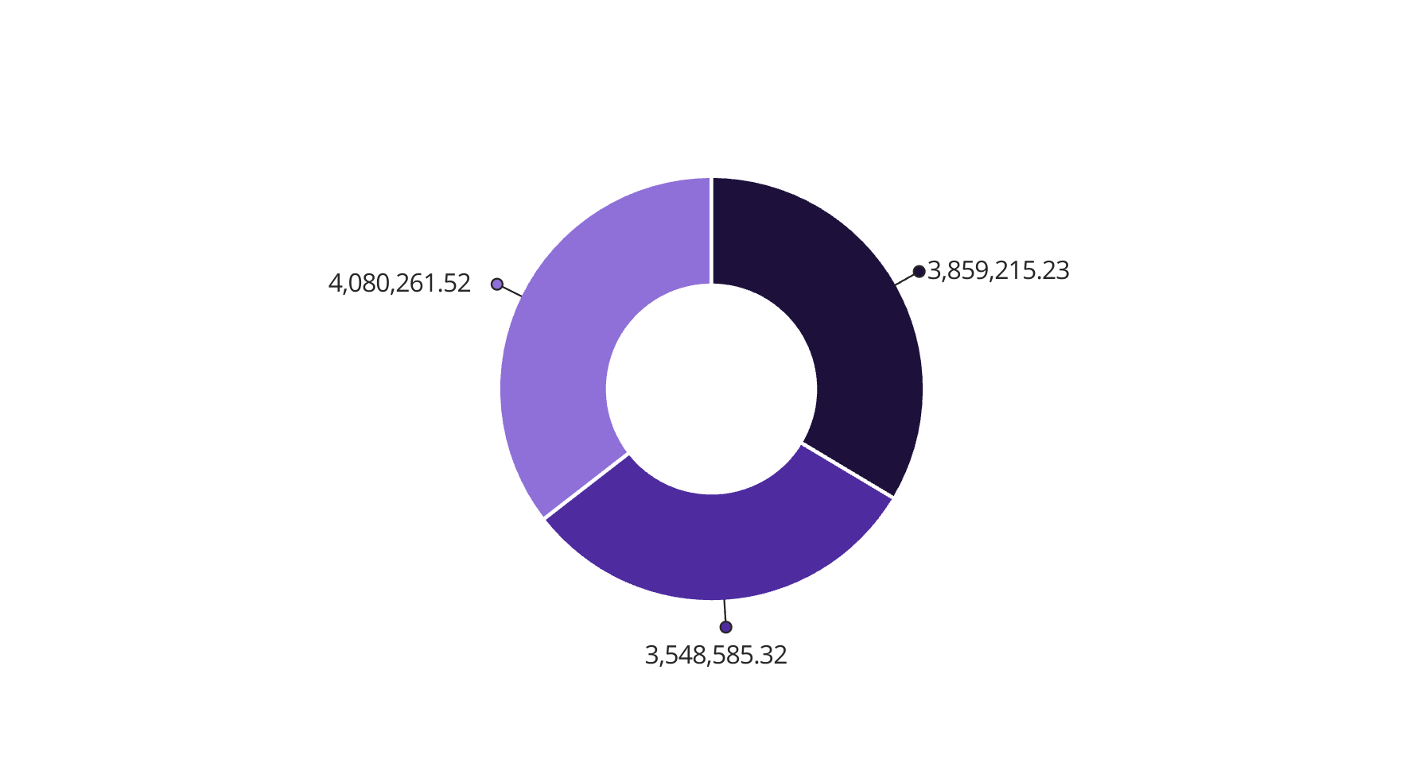
Sales per each categories
Technology contributes the highest profit, making up 50.79% of total profits.
Followed by Office Supplies with 42.77%, indicating strong demand and efficient pricing.
Furniture, however, lags behind at 6.44%, which may need strategic pricing or promotional support.
Furniture
Office Supplies
Technology

Slide 12
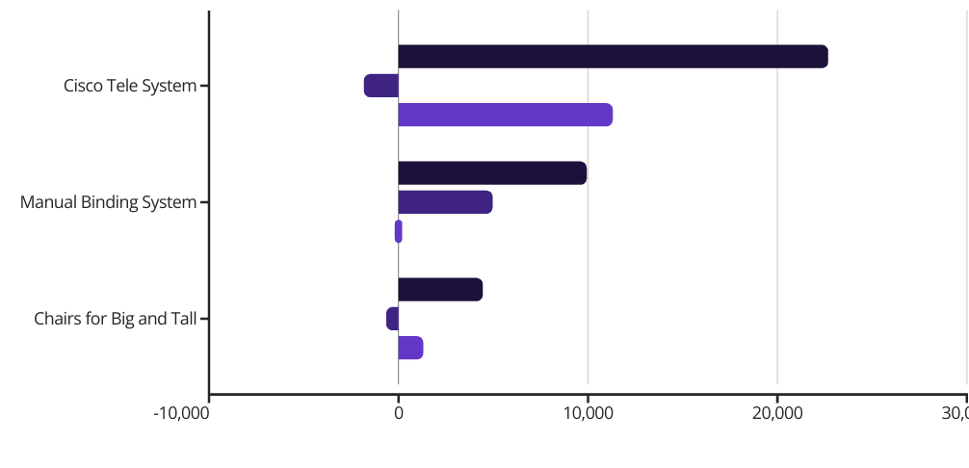
Analysis the Top 1 Product in each Category:
Technology: Cisco Tele System
Significant discounting caused a net loss despite strong sales.
Furniture: Chairs for Big and Tall
Another unprofitable item, calling for a review of discount strategies.
Office Supplies: Manual Binding System
Highest profit without discount – an example of an ideal pricing model !
Sales
Profit
Discount Value

Slide 13
Top 10 Products
Product Name
Total Sales
Total Profit
Discount Value
Canon imag
253,399.28
25,199.93
5,599.98
GBC Ibimaster 500 Manual ProClick Binding System
171,524.89
760.98
5,250.76
Cisco TelePresence System
135,830.88
-1,811.08
11,319.24
Chairs for Big and Tall
124,494.05
0
4,079.70
Hewlett Packard LaserJet 3310 Copier
111,478.14
6,983.88
2,735.95
Plastic Comb Binding Machine
100,662.41
7,753.04
4,067.17
HP Designjet T520 Inkjet Large Format Printer - 24" Color
79,624.55
4,094.98
1,312.49
GBC DocuBind P400 Electric Binding System
77,304.23
-1,878.17
5,280.64
Electric Binding System
74,001.68
2,233.51
4,458.04
High Speed Automatic Electric Letter Opener
67,466.24
-262
786.01

Slide 14


Sub Category Analysis
Most Ordered
Most Returned
Tables
Binders
Storage
Paper
Phones
Phones
Chairs
Furnishings
Binders
Storage

Slide 15

Dual Presence of Sub-Categories in Sales & Returns One striking insight is the presence of common sub-categories in both the Top Selling and Most Returned lists
Sales
Chairs
Phones
Returned
Tables
Paper
Binders
Storage
Furishgs
🔍 Analysis of Possible Reasons:
1- High discounts can attract a large number of purchases, but sometimes they’re applied to products with quality issues or ones that don’t meet customer expectations, which increases the likelihood of returns.
2- Customer Segment Most of the returns are from the Consumer Segment individual consumers are often more sensitive than businesses when it comes to product quality, size, or pricing issues.

Slide 16
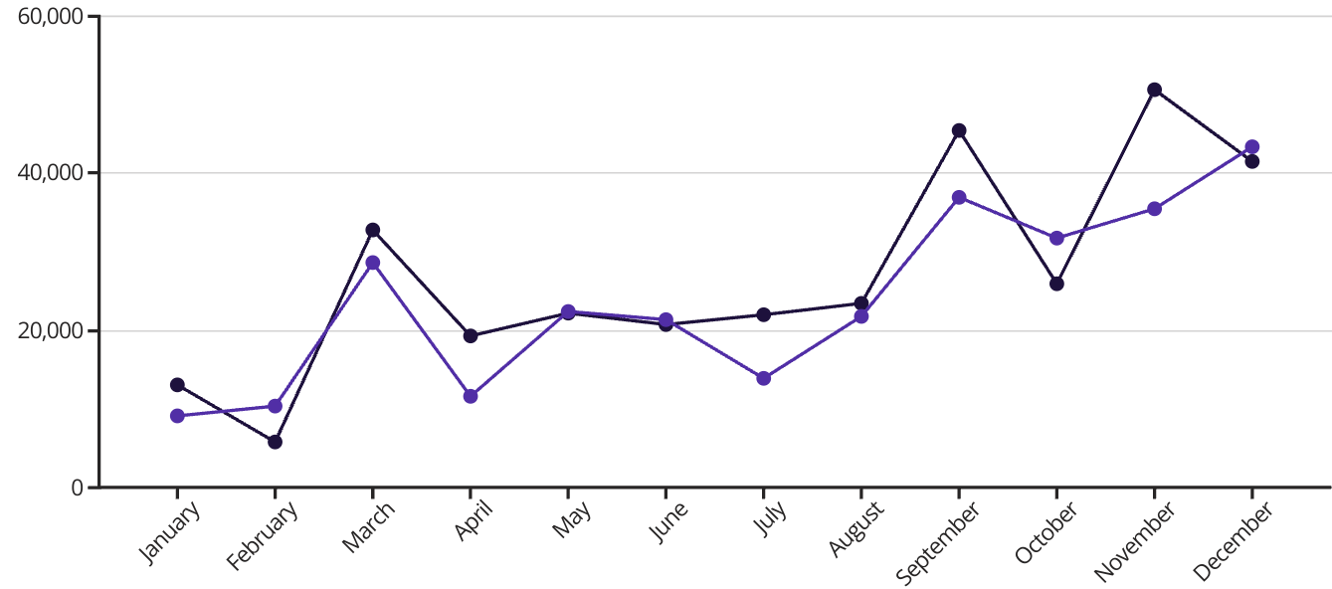
Profit vs Discount
Discount Value
Profit
Discount value and profit tend to move in opposite directions - when discount value is high, profit is lower, and vice versa.
The highest discount value was in November at over $50,000, while the highest profit was in December at over $43,000.
Notes:
The chart shows the relationship between profit and discount value over the course of a year. We can see that discount value and profit tend to move in opposite directions - when discount value is high, profit is lower, and vice versa. The highest discount value was in November at over $50,000, while the highest profit was in December at over $43,000. Analyzing this data can help us understand the tradeoffs between offering discounts and maintaining profitability. We'll want to find the right balance to maximize revenue while keeping customers satisfied.

Slide 17
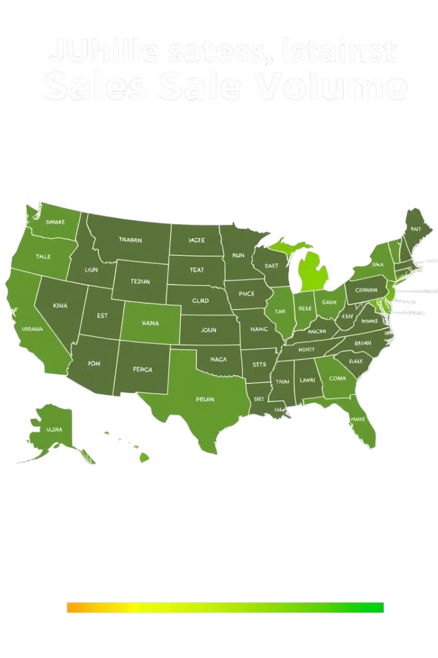
State-wise Performance
California , New York and Texas are the top-performing states, driving the highest sales revenue.
North Dakota and West Virgina are the lowest

Slide 18
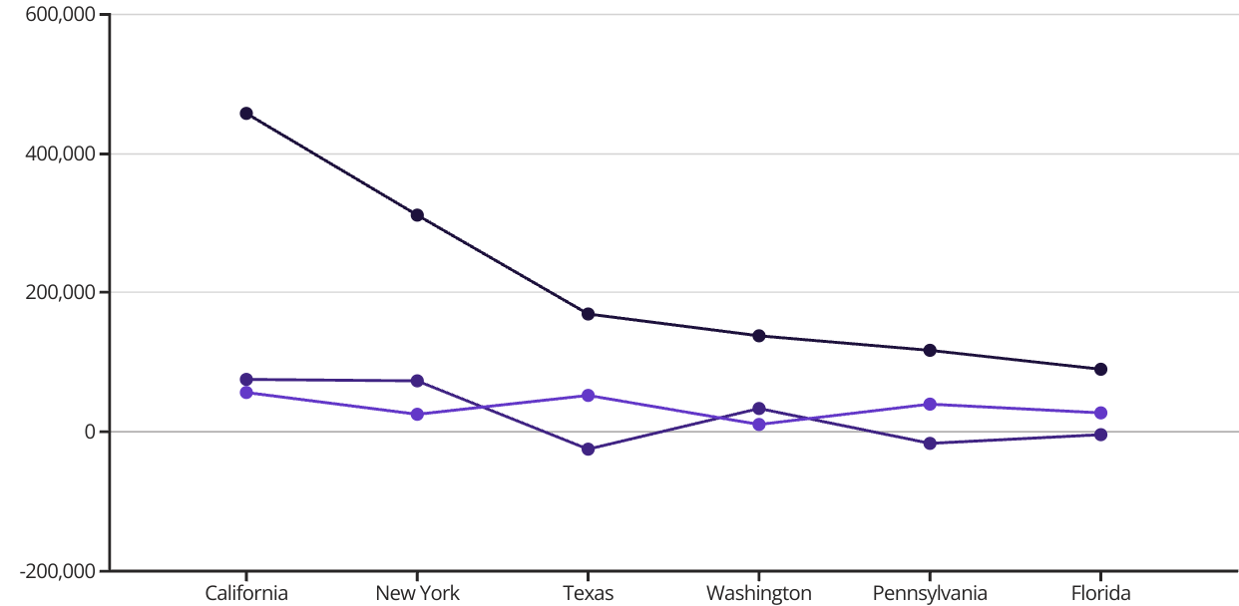
Top sales State per Profit
Sales
Profit
Discount Value
Allthough Texas was of the top sales state ,it had negative profit of $-25,000 on $170,000 in sales, the lowest of the states shown as it has a high discount value
Notes:
• California is our top sales state by profit, generating over $76,000 in profit on $457,000 in sales. This is an impressive performance. • New York is our second highest state by profit, with $74,000 in profit on $311,000 in sales. They are a strong performer as well. • Texas had negative profit of $-25,000 on $170,000 in sales, the lowest of the states shown. This is concerning and we'll need to investigate further. • Washington generated $33,000 in profit on $139,000 in sales, a solid result. • Pennsylvania and Florida both had negative profit, at $-16,000 and $-3,400 respectively. We'll need to focus on improving their performance. • Overall, California and New York are our top performing states by profit, while Texas, Pennsylvania, and Florida need more attention.

Slide 19




Sales-Men Performance
Every one has one Region
31.6%
17.1%
29.6%
21.9%
Anna Andreadi
Casssandra Brandow
Chack Mangee
Kelly Williams
West
South
East
Central
Total sales : 725.5 K
Total sales : 391.7 K
Total sales : 678.8 K
Total sales : 501.2 K
Notes:
This slide provides an overview of the top sales performers in the organization. Anna Andreadi is the top performer, accounting for 31.6% of total sales. Chack Mangee is the second highest performer, contributing 29.6% of sales. Kelly Williams is the third highest performer, responsible for 21.9% of sales. Cassandra Brandow rounds out the top performers, generating 17.1% of total sales. I'll highlight the key strengths and accomplishments of each of these top sales representatives.

Slide 20



Customer Insights
Spend
Repeat
Avg. 2.9k per visit.
99% buy more than 1 times.
58% buy more than 10 times.

Slide 21
Top 10 Customer
Customer Name
Total Sales
Profit
Discount Value
Total Order
Quantity
Returns Order
Ken Lonsdale
74,912.31
806.86
842.58
12
113
0
Greg Tran
73,016.05
2,163.43
1,689.38
11
106
0
Patrick O'Brill
69,297.41
38.48
1,731.39
11
91
0
Adrian Barton
143,857.71
5,444.81
732.12
10
73
1
Maria Etezadi
71,594.30
1,859.47
1,185.57
10
82
0
Joseph Holt
80,520.04
-644.7
2,154.45
6
64
1
Bill Shonely
71,586.33
2,616.06
88.71
5
39
0
Sean Miller
146,749.77
-1,980.74
11,989.06
5
50
1
Tamara Chand
92,602.57
8,981.32
42.06
5
42
1
Becky Martin
88,175.27
-1,659.96
4,064.30
4
64
0

Slide 22
Final Dashboard

Slide 23
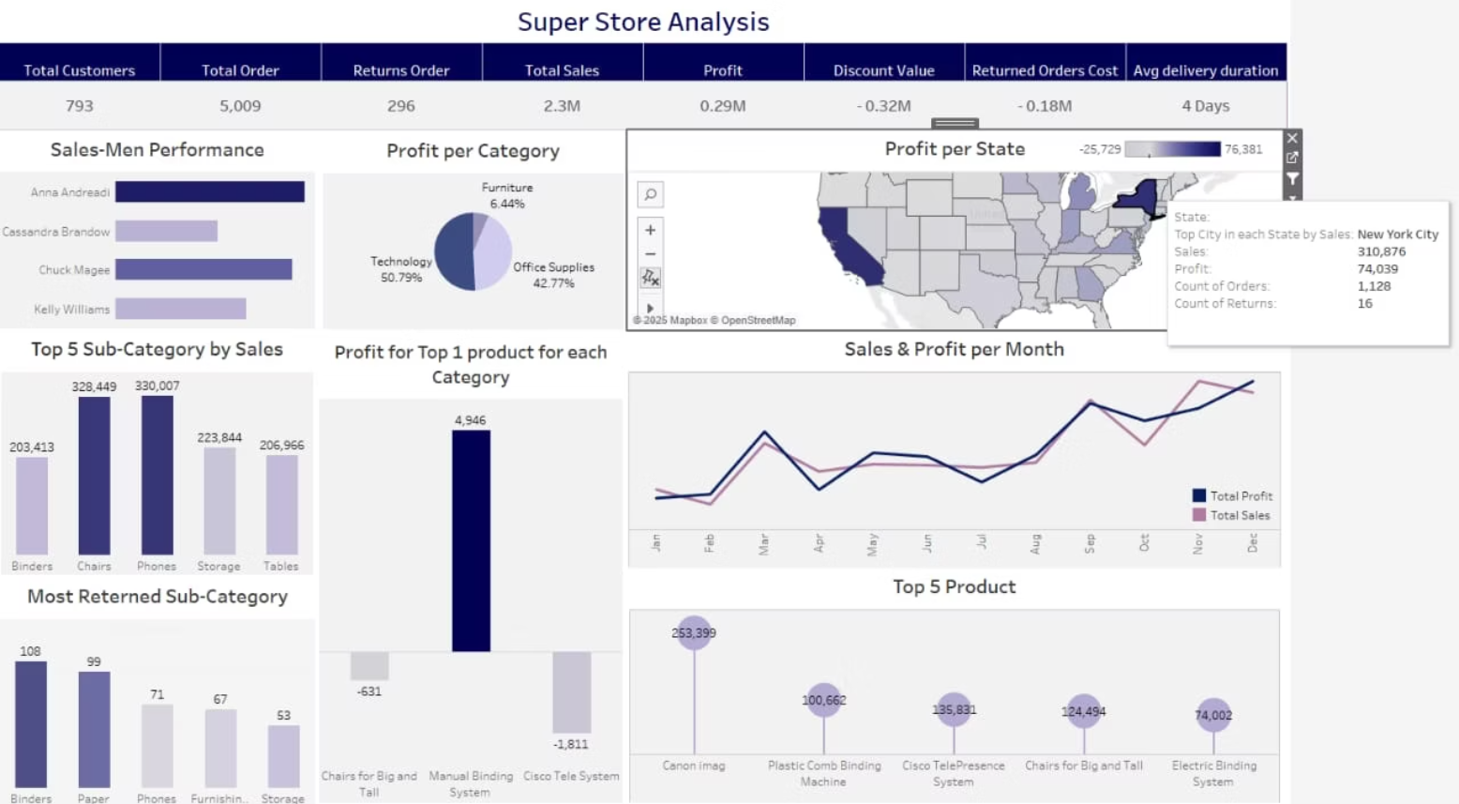

Slide 24
Forcasting

Slide 25
Conclusion
The store has strong sales volume but needs to shift focus from revenue generation to profit optimization. Small adjustments to discounting practices and product mix could dramatically improve profitability without reducing sales volume.

Slide 26



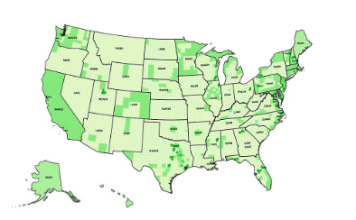
Major Problems Identified
Excessive Discounting
High Return Rates
Unprofitable Categories/Products
Geographical Imbalances
5.9% return rate is costing $0.18M
This is the primary reason for low profitability despite high sales volume
Furniture category has very thin margins (5.41%)
Some states are consistently unprofitable
Return costs are 62% of total profits
Some top-selling products are generating losses

Slide 27
Recommendations
Discount Strategy Overhaul:
Implement targeted discounts rather than blanket reductions
Use discounting strategically to move slow inventory, not all products
Set maximum discount thresholds per product category
Returns Reduction Program:
Analyze reasons for returns (quality issues, wrong items, etc.)
Implement better product descriptions and images
Consider restocking fees for frequent returners
Product Mix Optimization:
Reduce focus on low-margin furniture items
Expand high-margin technology offerings
Discontinue consistently unprofitable products
Regional Strategy Adjustment:
Investigate why some states perform poorly
Consider reducing marketing/spending in consistently unprofitable regions
Replicate successful state strategies elsewhere

